Slide 1

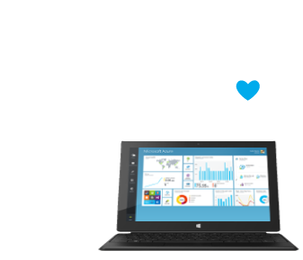
Introduction to Azure
Microsoft's application platform for the public cloud
Web Services and Cloud
Telerik Software Academy
http://academy.telerik.com

Slide 2
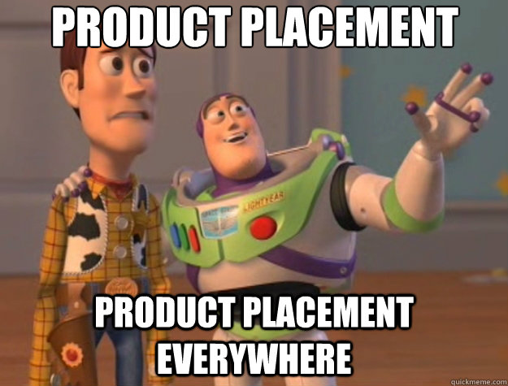

Slide 3
Table of Contents
What is Microsoft Azure?
Compute Services and Virtual Machines
Demo: Windows Server and Ubuntu
Demo: RemoteApp
Data and Storage
Web and Mobile
Demo: Deploying ASP.NET MVC and Web API
Demo: Continuous Deployment
Internet of Things, Big Data, Machine Learning
Networking, Mobile, Back-up
Messaging and Integration
Compute Assistance, Performance, Media

Slide 4
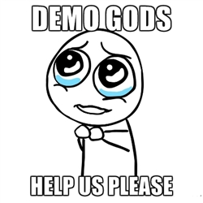

Slide 5
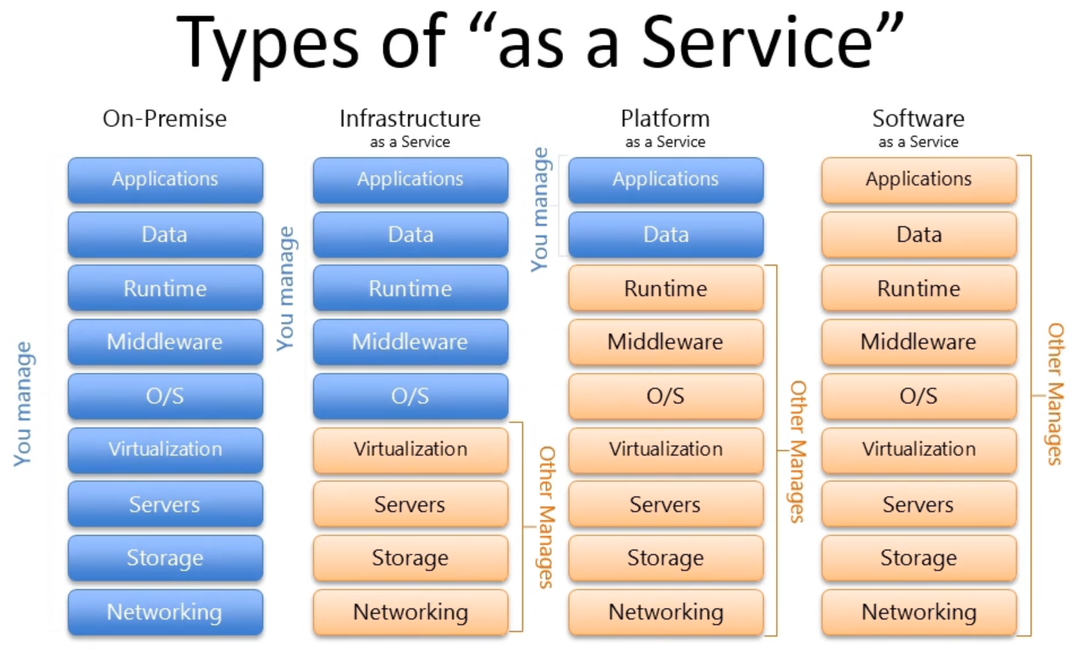
Cloud Computing
A virtualized computing platform that provides infinite resources for running your applications
Leverages economies of scale to save you money (pay for what you use)

Slide 6
What is Microsoft Azure?
Microsoft Azure is a cloud computing platform and infrastructure created by Microsoft
Commercial 1, Commercial 2, Commercial 3
It is provided in Microsoft datacenters located around the world (US, Europe, Asia, Australia)
https://youtube.com/watch?v=0uRR72b_qvc
It provides a range of services that developers and operations people can use, including:
Running and connecting applications
Storing, managing and analyzing data
Networking, media (CDN), IoT, security and more

Slide 7
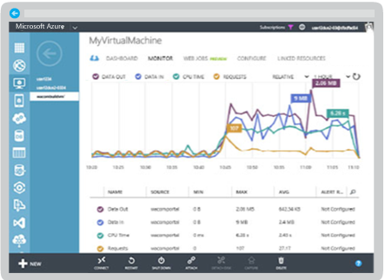
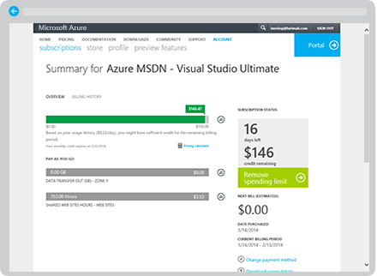
The Components of Azure
Azure has a web interface called the Management Portal that allows you to access and administer most, but not all Azure features
Usage and billing track your Azure usage and view your bill. Azure charges only what you use

Slide 8
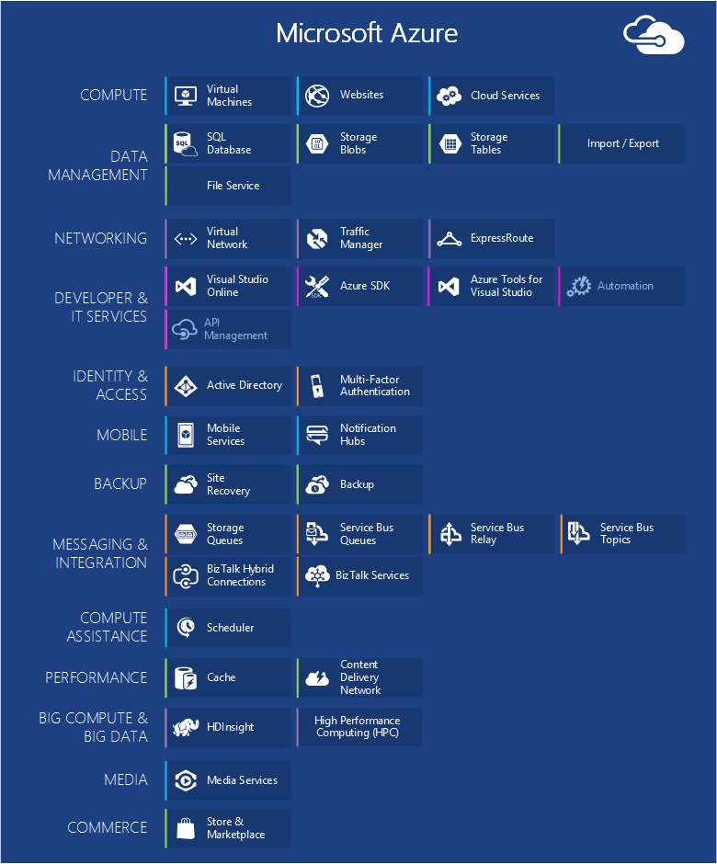
The Components of Azure (2)
Virtual Machines
Web Applications
Cloud Services
Data Management
Networking
Developer Services
Identity and Access
Mobile Services
Back-up
Azure Marketplace
Integration with VS

Slide 9
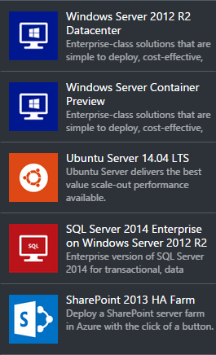
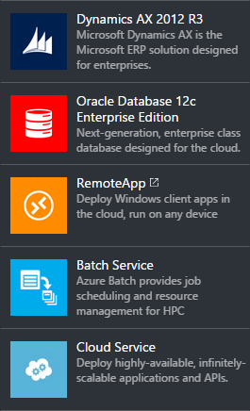
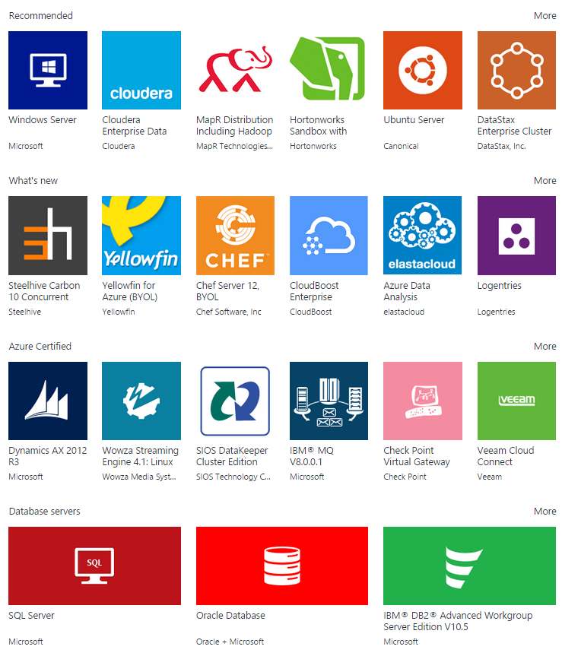
Computing
Computing cloud solutions provided by Azure:

Slide 10
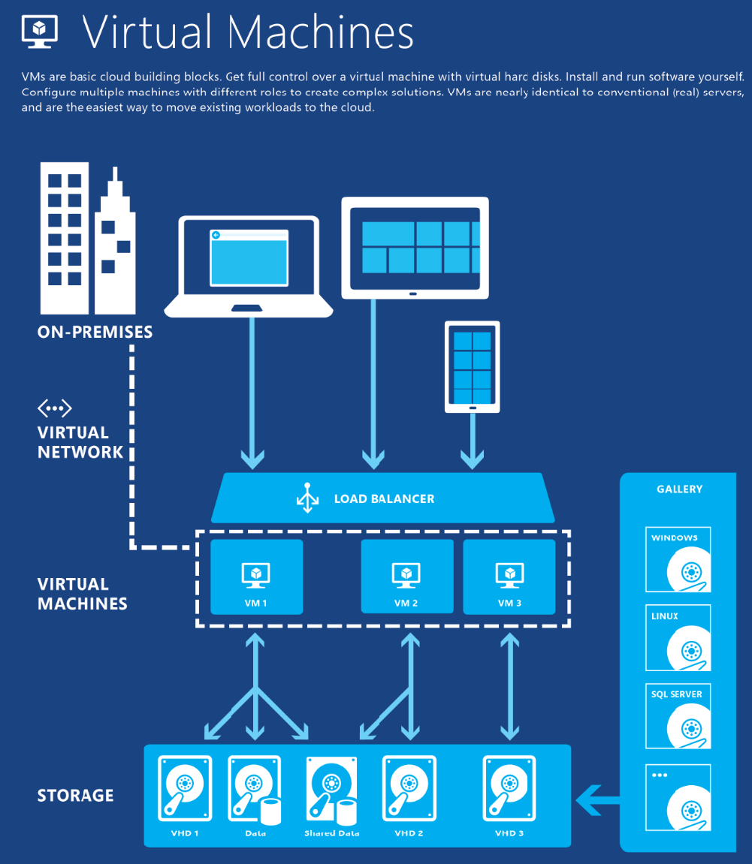
Azure Virtual Machines
Infrastructure as a Service
Windows and Linux VMs
Virtual Machine Scenarios
Development / Test
Move/Run Applications in Azure (Lift-and-shift)
Extend your Datacenter
Commercial video
Built-in Virtual Networking, Load Balancing
Scale from 1 to 1000s of VM Instances
Great choice of configurations and per-minute billing

Slide 11
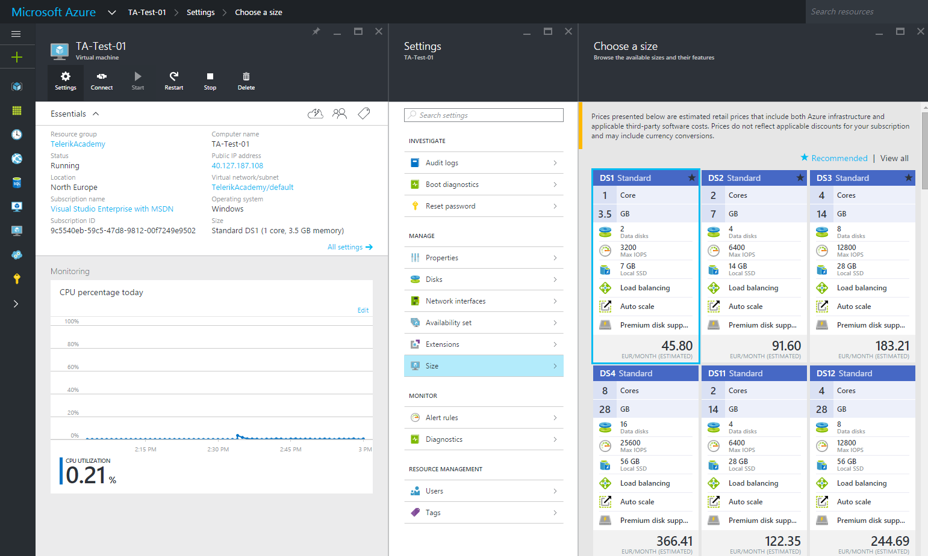
Demo: Windows Server and Ubuntu
Create Windows Server (and Ubuntu) VM
Connect using Remote Desktop / SSH
Manage the Virtual Machines
Upgrade Resources (CPU and RAM)

Slide 12
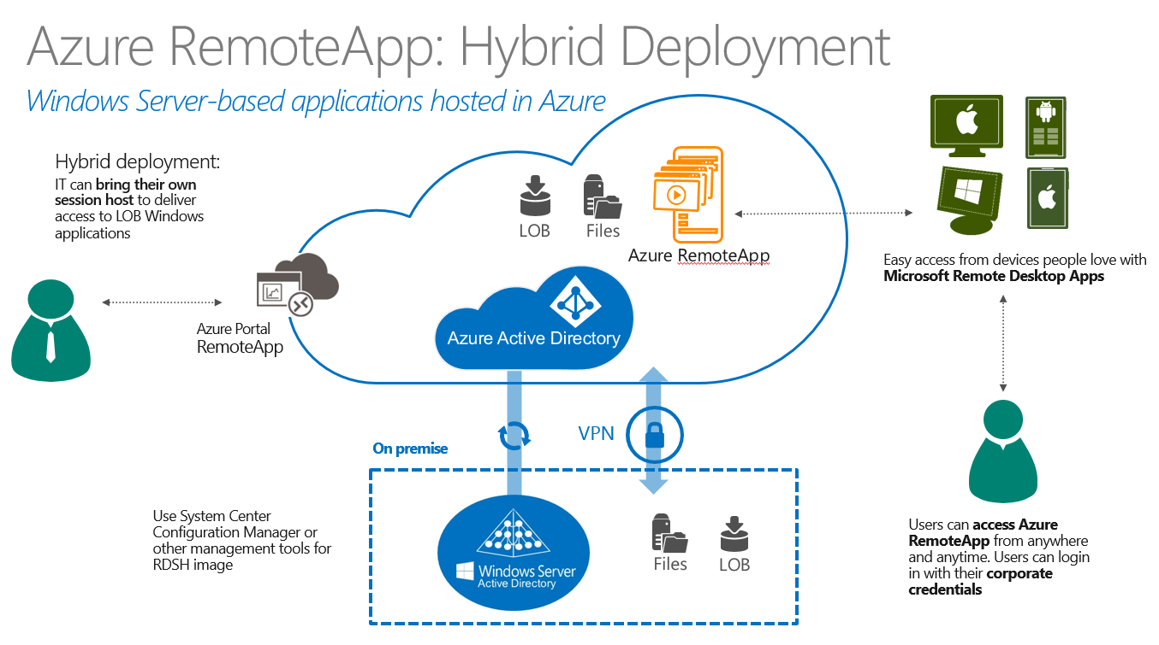
Demo: RemoteApp
https://youtube.com/watch?v=DSuCqmWlr0s
Create RemoteApp from Office Template
Install Azure RemoteApp Client
Connect and Use the Remote Applications

Slide 13
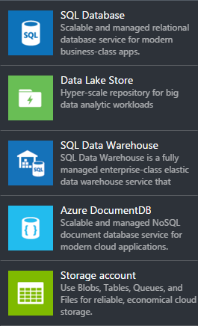
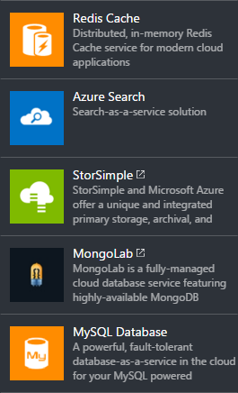
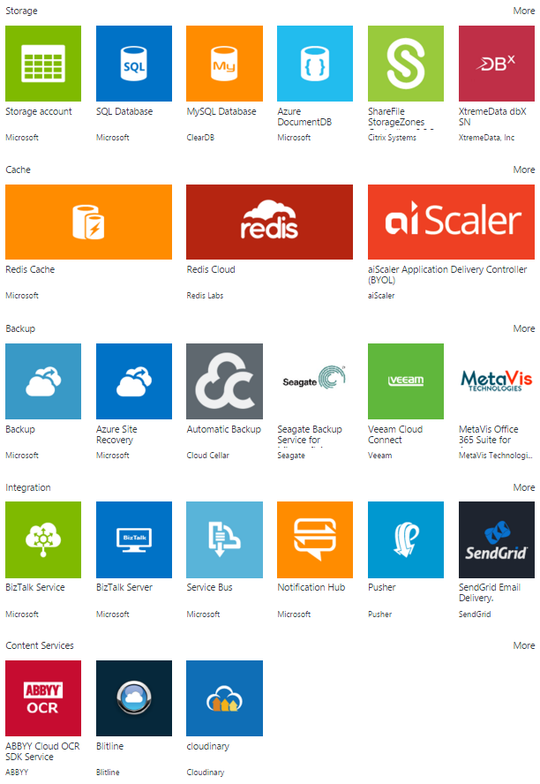
Data + Storage
https://youtube.com/watch?v=kukyVj9rQ1Y
https://youtube.com/watch?v=Nn4_EdyN6FM
https://youtube.com/watch?v=FWGtgpzjAPM

Slide 14
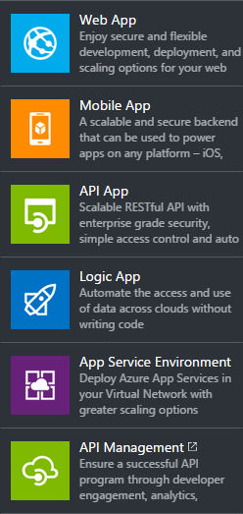
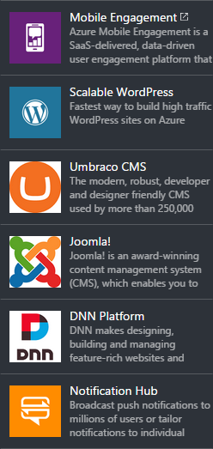
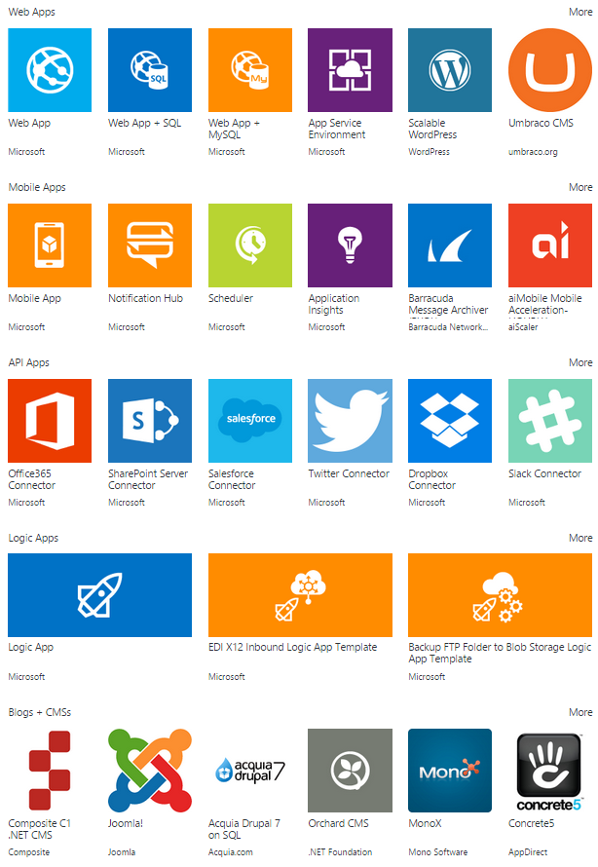
Web + Mobile
Web and Mobile Services by Microsoft Azure

Slide 15
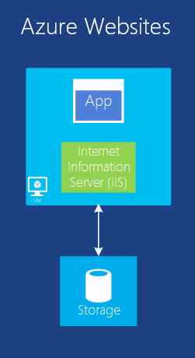
Web Applications
One of the most common things to do in the cloud is to run web apps
VM can do the work but it leaves you with the administering
This compute model offers a managed web environment
Easy deploying with Visual Studio and Continuous Deployment
Management Portal and API
Scaling and Load Balancing
Supports .NET, PHP, Node.js, Java and Python along with SQL Database and MySQL

Slide 16
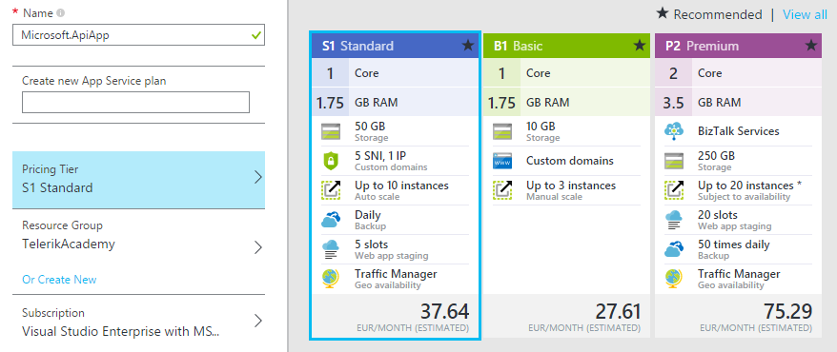
Demo: ASP.NET Web API and MVC in Azure
Create simple ASP.NET WebAPI / MVC application
Attach Azure Publish Profile
Deploy the Application
Login/Register

Slide 17
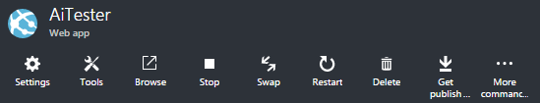
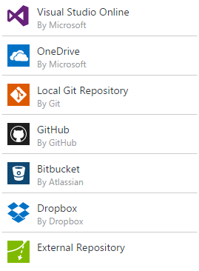

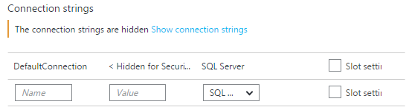
Demo: Continuous Deployment
https://youtube.com/watch?v=3WDe3l1M-3U
Create a new web app
Attach Continuous Deployment
Create a new SQL Server Database
Update DefaultConnection Connection String

Slide 18
Data, Analytics and IoT
TODO

Slide 19
More Videos
Machine Learning
https://youtube.com/watch?v=SJtNJepz-pM
https://youtube.com/watch?v=l6dsLyueF0Q
Microsoft Advanced Threat Analytics
https://youtube.com/watch?v=-MGg_07MkgY
Internet of Thinks
https://youtube.com/watch?v=L8xjSjxaaVA
https://youtube.com/watch?v=Z7GzCjT77Po
Azure Support
https://youtube.com/watch?v=epfmTG9ix1g
App Service
https://youtube.com/watch?v=sUlppU0GBKw

Slide 20
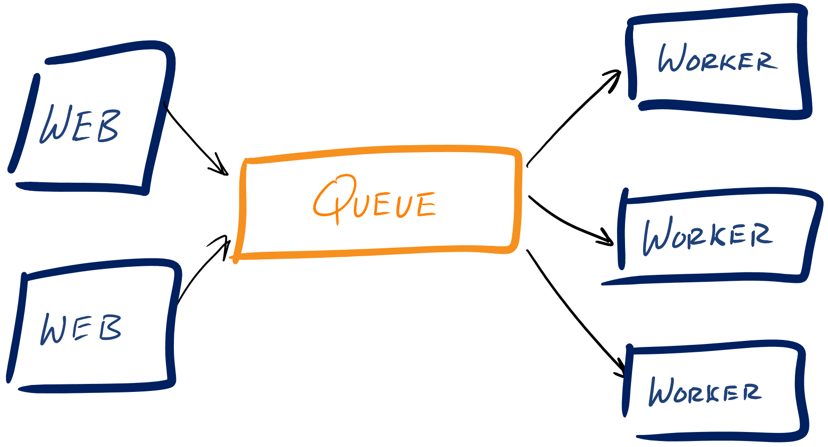
Popular Cloud Architectures
A Web Role is an Azure VM that is pre-configured as a web server (running ASP.NET MVC for example)
Worker Roles run alongside your Web Roles and are responsible for performing computing functions to support your application

Slide 21
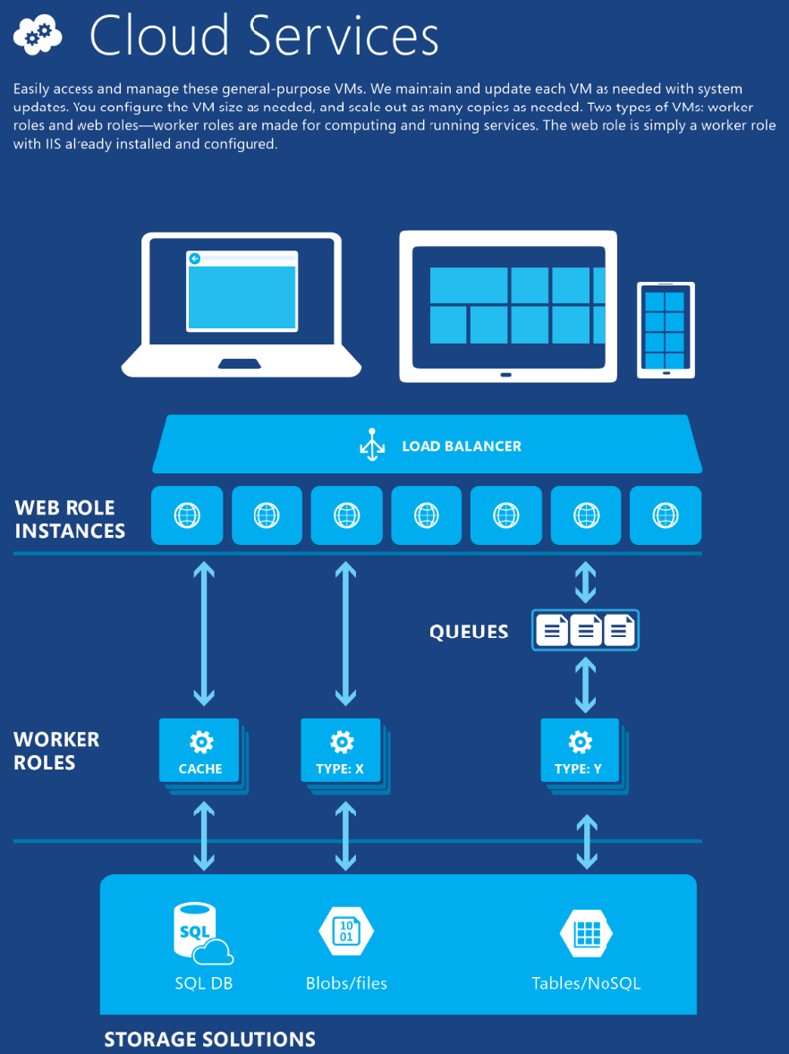
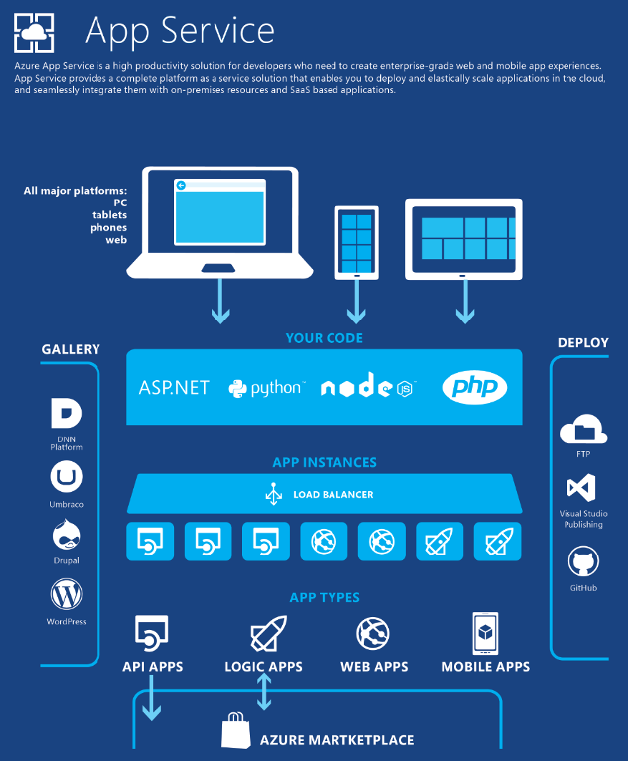

Slide 22
Questions?
Introduction to Azure

Slide 23




Free Trainings @ Telerik Academy
C# Programming @ Telerik Academy
csharpfundamentals.telerik.com
Telerik Software Academy
academy.telerik.com
Telerik Academy @ Facebook
facebook.com/TelerikAcademy
Telerik Software Academy Forums
forums.academy.telerik.com

